Slide 1
Car Insurance Claim Prediction
Avinash Nalawade

Slide 2
Introduction
Overview
The car insurance industry faces significant challenges in managing claim costs and reducing fraud. Predicting the likelihood of a car insurance claim can help insurers manage risks, set premiums more accurately, and detect fraudulent claims early. By leveraging machine learning techniques, we can develop models to predict these claims with higher accuracy.
Objective:
The primary goal of this project is to predict the likelihood of a car insurance claim using various machine learning algorithms. The project aims to:
Analyze the dataset to understand the key factors influencing claims.
Preprocess the data to ensure it is suitable for model training.
Train multiple machine learning models and evaluate their performance.
Select the best-performing model to predict future claims.

Slide 3
Significance:
Accurately predicting car insurance claims has several benefits:
Risk Management: Helps insurers identify high-risk customers and adjust premiums accordingly.
Cost Reduction: Reduces the number of fraudulent claims, saving costs for insurers.
Customer Satisfaction: Enables insurers to offer personalized premiums, improving customer satisfaction.
By achieving these objectives, the project aims to contribute to the efficiency and effectiveness of the car insurance industry.
Project Steps:
Data Collection: Acquiring the dataset and understanding its structure.
Data Preprocessing: Cleaning and transforming the data to prepare it for modeling.
Exploratory Data Analysis (EDA): Analyzing the data to uncover patterns and insights.
Model Training: Training multiple machine learning models on the prepared data.
Model Evaluation: Evaluating the models using appropriate metrics to determine the best performer.

Slide 4
jij
Description:
Number of Records: The dataset contains [number] records.
Number of Features: The dataset includes [number] features, encompassing various attributes related to car insurance policies and claims.
Key Features:
Policy_ID: Unique identifier for each insurance policy.
Policy_Holder_Age : Age of the policyholder.
Vehicle_Age: Age of the insured vehicle.
Annual_Premium: The annual premium paid for the insurance.
Number_of_Claims: Number of claims made by the policyholder.
Claim_Amount: The amount claimed.
Location: Geographic location of the policyholder.
Vehicle_Type: Type of vehicle (e.g., sedan, SUV).
Claim: Target variable indicating if a claim was made (1) or not (0).
Dataset

Slide 5
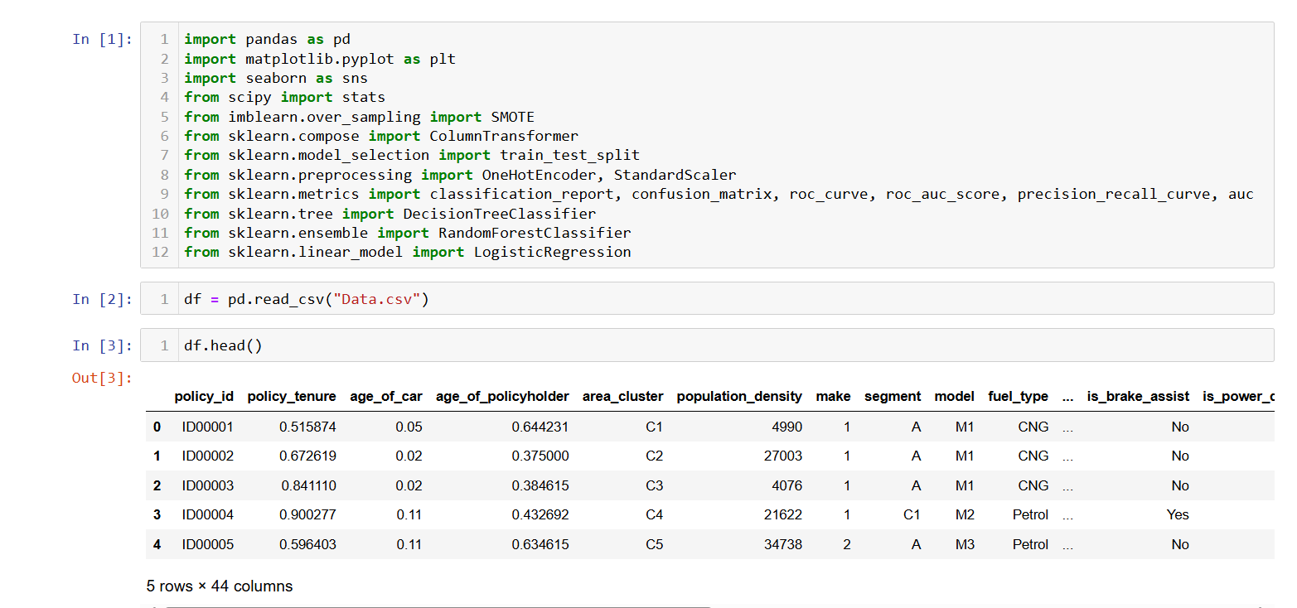

Slide 6
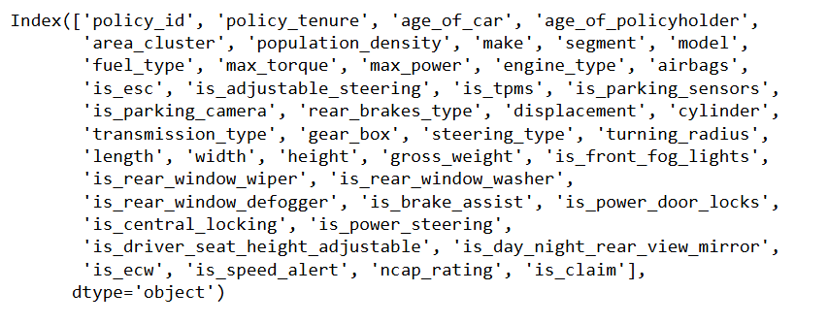
Columns
Columns

Slide 7
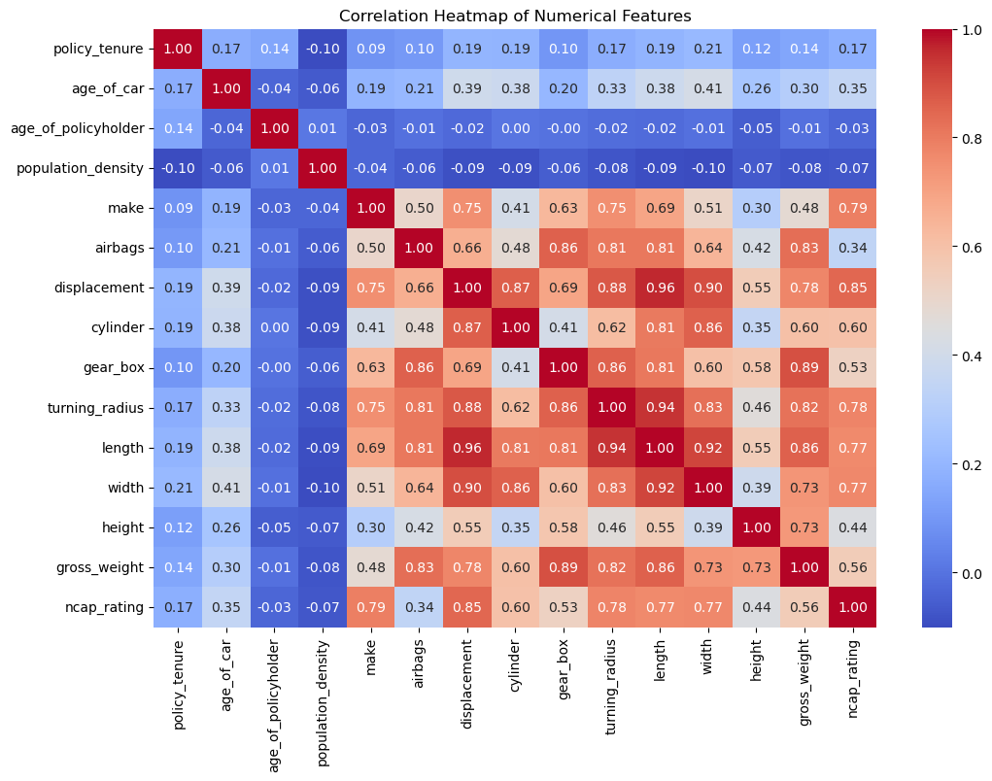
Heatmap

Slide 8
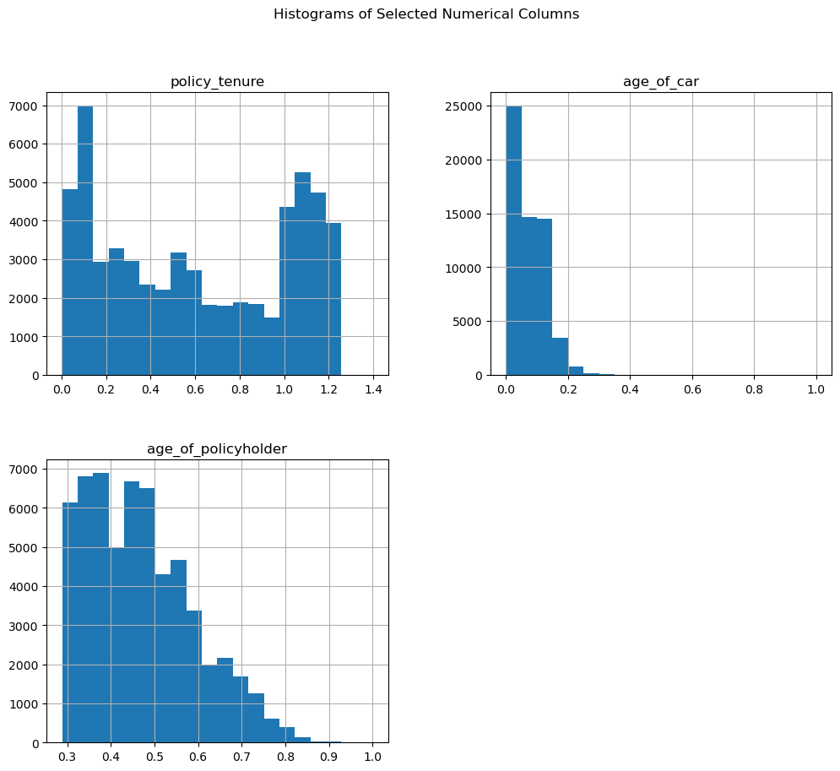
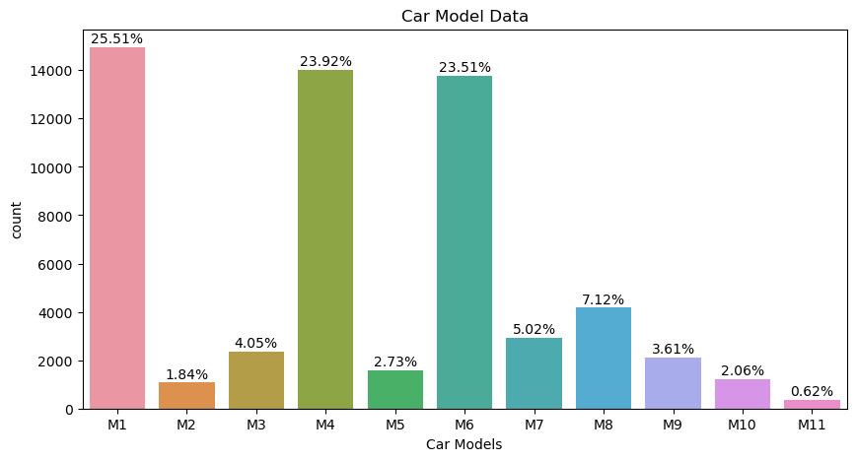
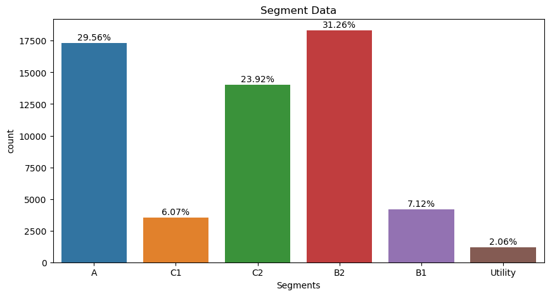
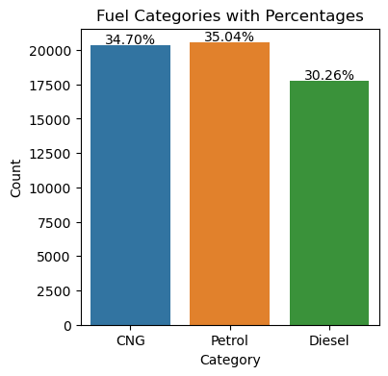
Visualizations

Slide 9
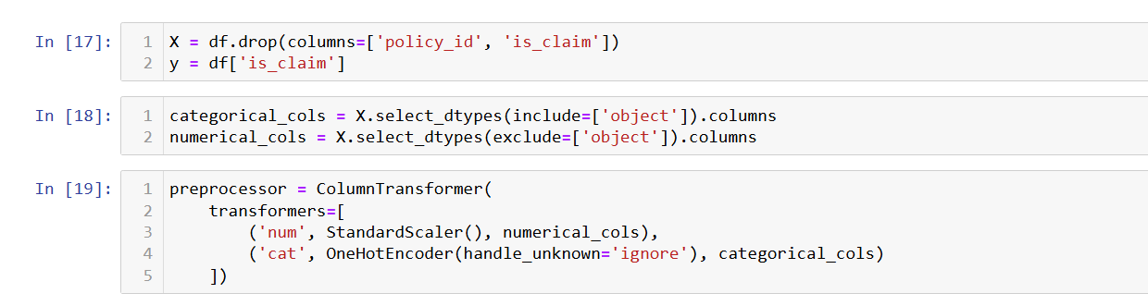
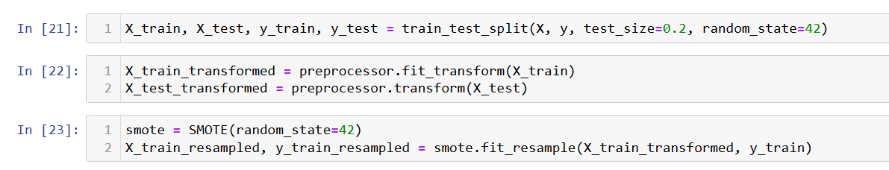
Fit and Transform
StandardScaler for
Standardize the features of a dataset
LabelEncoder used for encoding
Categorical variables as numerical variables. It converts each unique categorical value into a numerical
Split
X : The array of feature values
y : The array of target values
Test_size : The proportion of the data to be used for testing
Random_state : A random seed fro reproducibility
X_train : the array of feature values for training set
X_test : the array of feature values for testing set
y_train : the array of target values for training set
y_test : the array of target variable for testing set

Slide 10
Algorithms
Logistic Regression
DecisionTreeClassifier
RandomForestClassifier

Slide 11
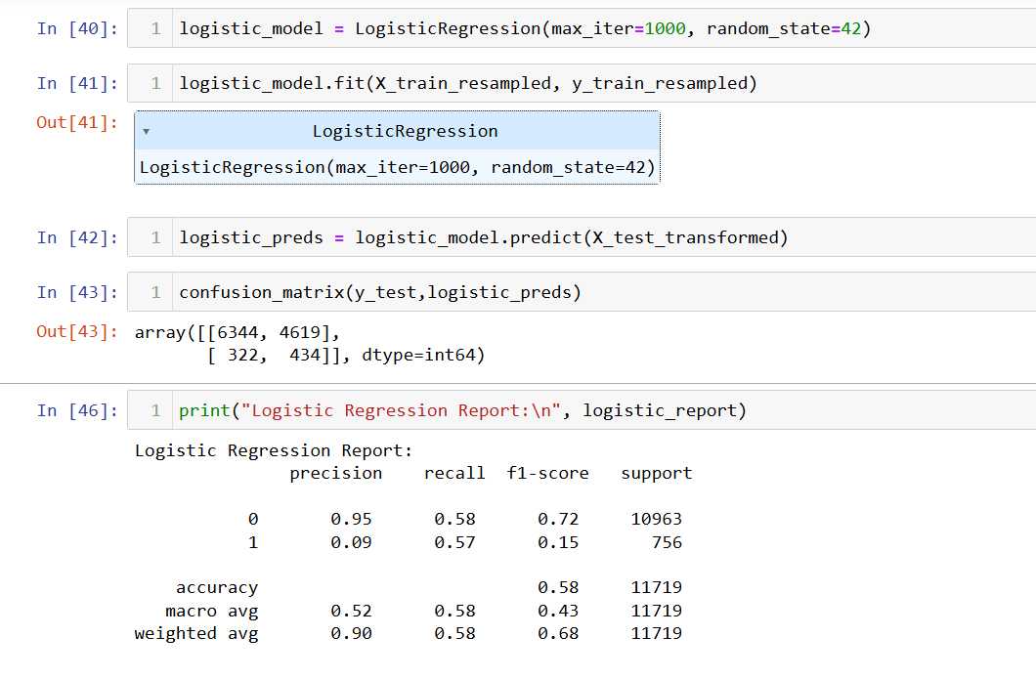
LogisticRegression

Slide 12
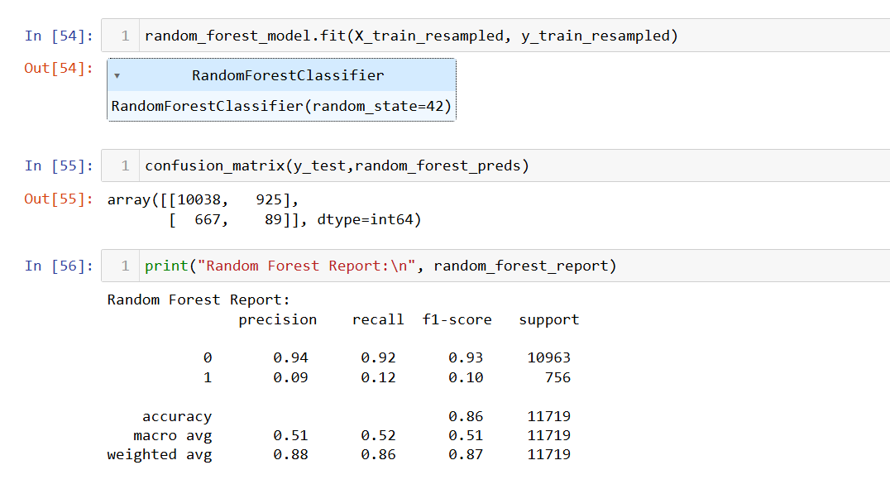
RandomForestClassifier

Slide 13
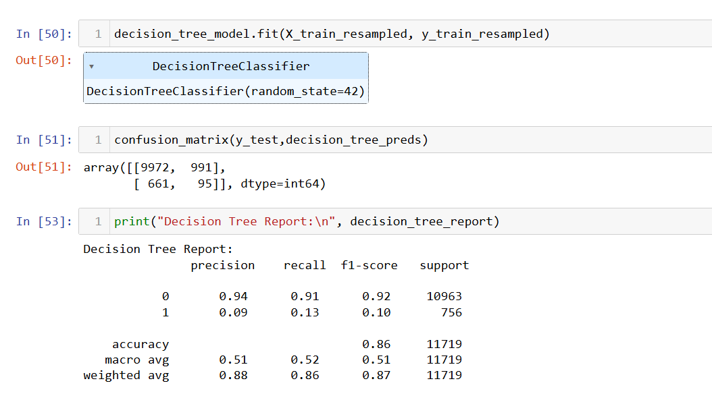
DecisionTreeClassifier

Slide 14
Comparison
DecisionTreeClassifier
RandomForestClassifier
LogisticRegression
Accuracy score = 0.86
Accuracy score = 0.86
Accuracy score = 0.58
………………………………….........
……………………………….

Slide 15
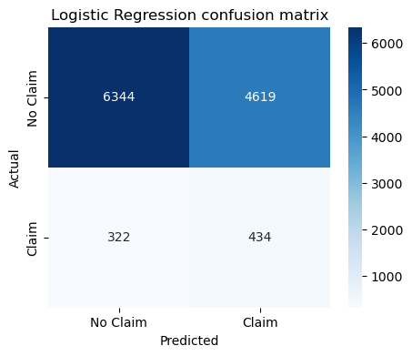
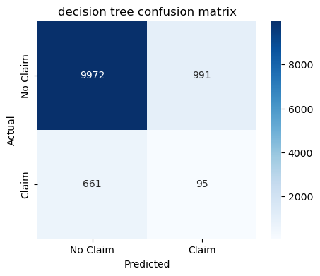
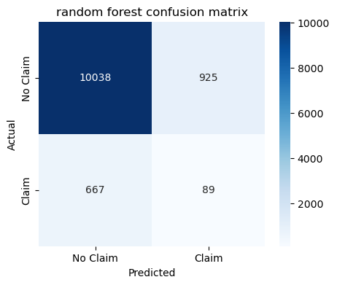
Confusion matrix Comparison

Slide 16
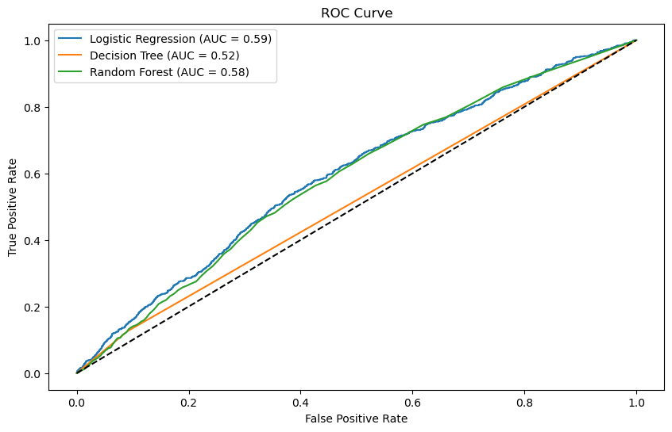
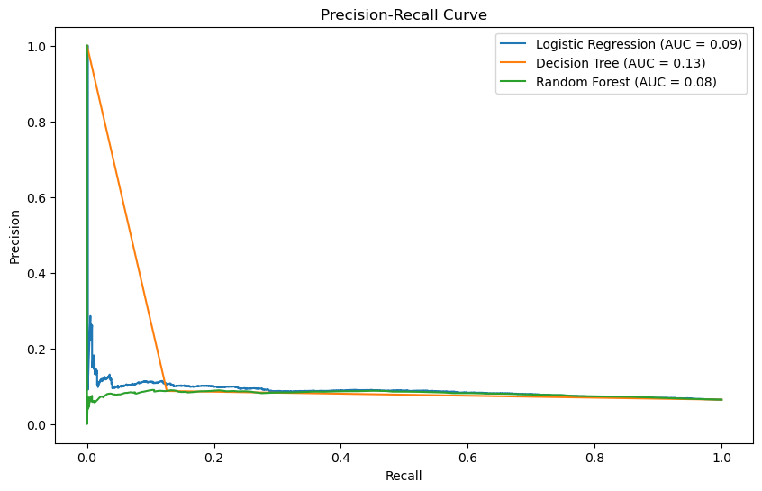
Comparison

Slide 17
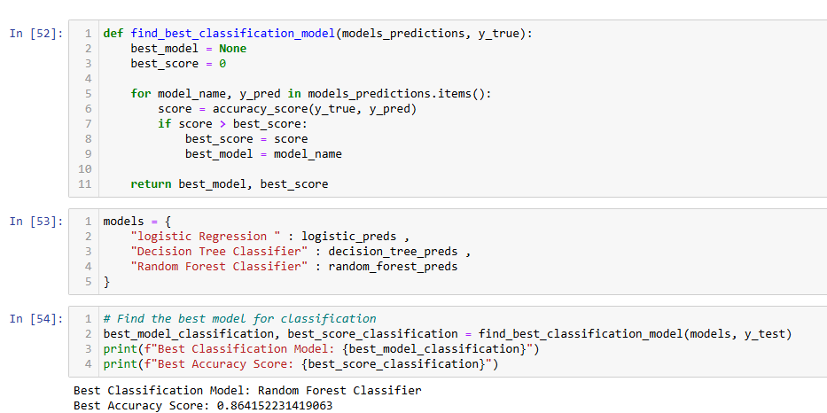
The best model with highest accuracy to be selected is [‘Random forest classifier’]

Slide 18
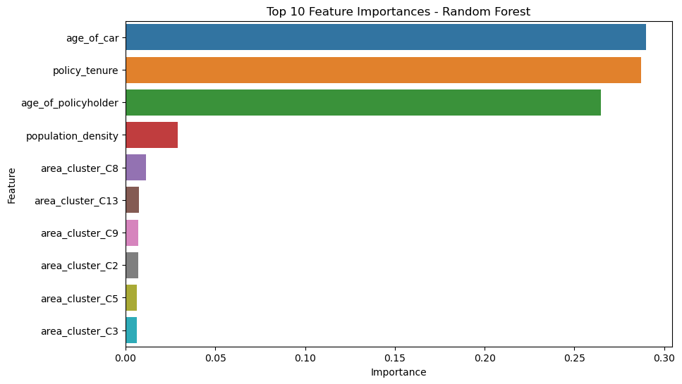
Important features

Slide 19
Conclusion
Summary of Findings:
The project successfully utilized machine learning models to predict car insurance claims.
Key factors influencing claims were identified and analyzed.
The best-performing model was selected based on evaluation metrics, providing accurate predictions.
Impact:
Improved risk management for insurers by identifying high-risk customers.
Cost reduction through early detection of fraudulent claims.
Enhanced customer satisfaction by offering personalized premiums.
Future Work:
Incorporating additional features such as driving behavior and telematics data for improved predictions.
Exploring advanced machine learning models and techniques.
Implementing the model in a real-world insurance setting and monitoring its performance over time.
Final Thoughts:
This project demonstrates the potential of machine learning in transforming the car insurance industry.
Continuous improvement and innovation are essential to stay ahead in the competitive insurance market.

Slide 20
Thank You !
Gratitude:
Thank you for your time and attention.
I appreciate the opportunity to present this project
Contact information :
Avinash Nalawade
harshnalawade244@gmail.com
+917249060794
Gratitude:
Thank you for your time and attention.
I appreciate the opportunity to present this project.
Contact Information:
Avinash Nalawade
harshnalawade244@gmail.com
+917249060794

